Slide 1

Convolutional Neural Networks & Zapier

Slide 2
Contents
What are Neural Networks
How Neural Networks work
What are CNNs
Convolutional Layer
Padding and Strides
Pooling Layer
Fully Connected Layer
Zapier

Slide 3
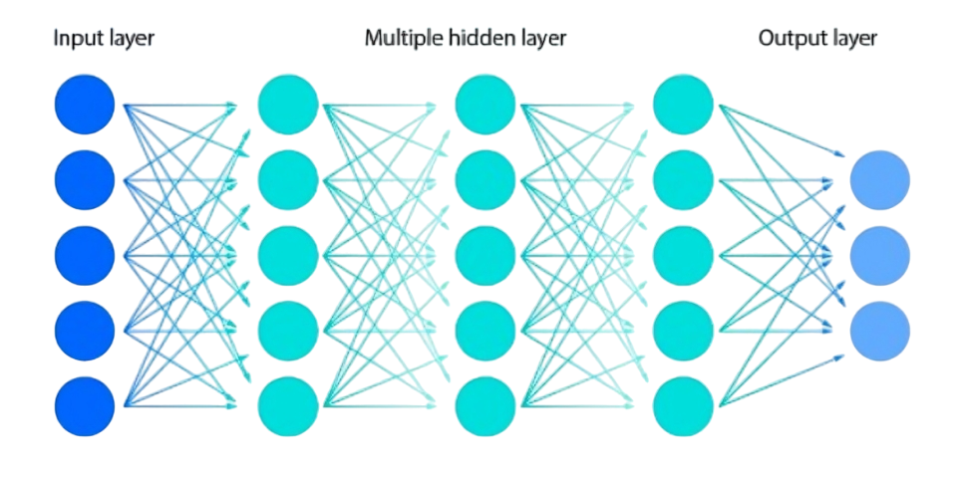
What are Neural Networks
A neural network is a method in artificial intelligence that teaches computers to process data in a way that is inspired by the human brain. It is a type of machine learning process, called deep learning, that uses interconnected nodes or neurons in a layered structure that resembles the human brain.
Source: IBM.com

Slide 4

Components of a Neural Network
Input Layer: This is where you feed your data into the network. Each neuron in the input layer represents one feature of your data. For example, if you're working with images, each neuron might represent one pixel.
Source: towardsdatascience.com

Slide 5
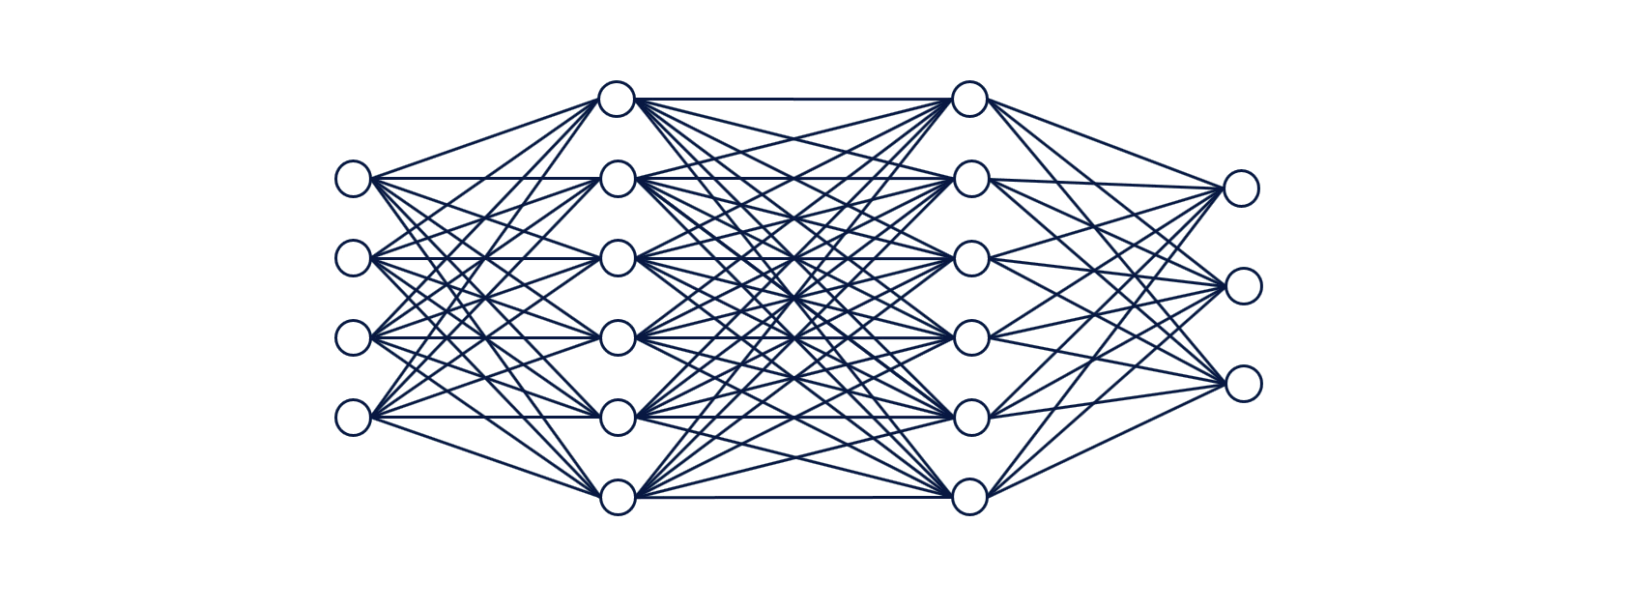
Components of a Neural Network
Hidden Layers: These are layers between the input and output layers. Each neuron in a hidden layer takes input from the neurons in the previous layer, applies some computation to it, and passes the result to the neurons in the next layer. These layers are called "hidden" because we don't directly observe their outputs.
Source: Medium.com

Slide 6
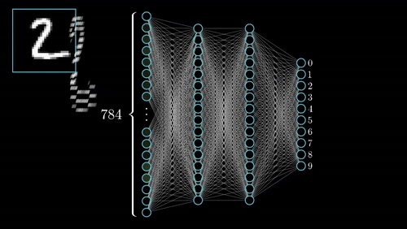
Components of a Neural Network
Output Layer: It produces the final output for the problem. For example, if we are classifying images of handwritten digits, we might have 10 neurons in the output layer, each representing one digit from 0 to 9. The neuron with the highest output value tells you the network's prediction for the input image.
Source: 3 Blue 1 Brown

Slide 7
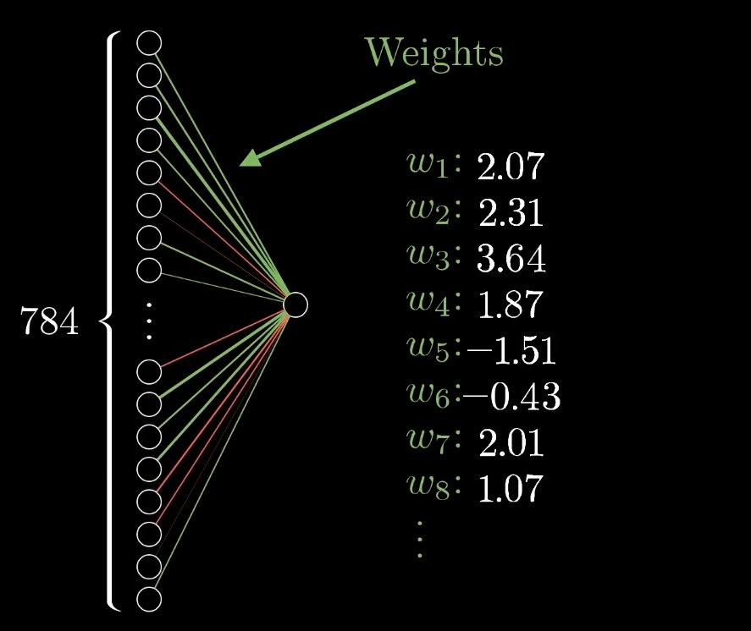
How Neural Networks Work
Input data is fed into the input layer.
The inputs are multiplied by the weights and passed through an activation function in each neuron in the hidden layers.
The process continues until the output layer is reached, and the final output is produced.
Source: 3 Blue 1 Brown

Slide 8
How Neural Networks Work
Neurons:
Neurons are the basic building blocks of a neural network. Each neuron receives input signals from the neurons in the previous layer, performs a computation on those inputs, and then produces an output signal.
The computation performed by a neuron involves summing up the weighted inputs and applying an activation function to the result.
Activation Functions:
Activation functions introduce non-linearity into the network, allowing it to learn complex patterns in the data.
Common activation functions include the sigmoid function, the hyperbolic tangent (tanh) function, and the rectified linear unit (ReLU) function.
The choice of activation function depends on the nature of the problem and the characteristics of the data.

Slide 9
How Neural Networks Work
Layers:
A neural network is typically organized into layers: an input layer, one or more hidden layers, and an output layer.
Each layer consists of multiple neurons that perform computations independently of each other but share the same set of weights.
Feedforward Propagation:
Feedforward propagation refers to the process of passing input data through the network to generate predictions.
During feedforward propagation, input data is fed into the input layer, and the output of each neuron is computed layer by layer until the output layer is reached.
The final output of the network is obtained by applying the activation function to the weighted sum of inputs in the output layer.

Slide 10
How Neural Networks Work
Backpropagation:
Backpropagation is the algorithm used to train neural networks by adjusting the weights to minimize the difference between the predicted outputs and the true targets.
It works by computing the gradient of the loss function with respect to the weights of the network using the chain rule of calculus.
The gradients are then used to update the weights in the opposite direction of the gradient, effectively "descending" the loss surface to find the minimum.
Loss Functions:
Loss functions quantify the difference between the predicted outputs of the network and the true targets.
Common loss functions include mean squared error (MSE) for regression tasks and categorical cross-entropy for classification tasks.

Slide 11
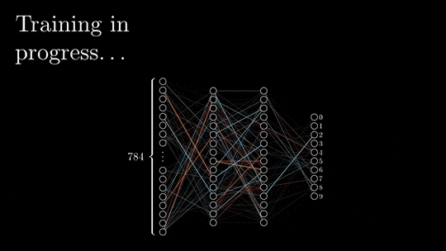
How Neural Networks Work
Source: Medium.com

Slide 12

How Neural Networks Work
Source: machinelearningknowledge.ai

Slide 13
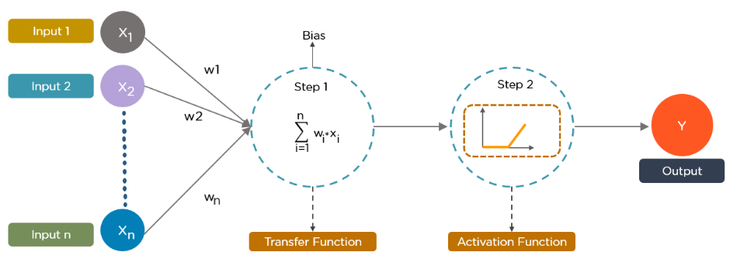
How Neural Networks Work
Summary of its working:
Source: superdatascience.com

Slide 14
Disadvantages of ANNs in image classification
Not specifically designed to capture spatial structure
Less scalable due to the high number of parameters and overfitting
Requires a large amount of training data to avoid overfitting
Less computationally efficient, especially for large images or deep architectures

Slide 15
What are CNNs
Convolutional Neural Networks also known as CNNs or ConvNets, are a type of feed-forward artificial neural network whose connectivity structure is inspired by the organization of the animal visual cortex.
Individual neuronal cells in the brain respond or fire only when certain orientations of edges are present. Some neurons activate when shown vertical edges, while others fire when shown horizontal or diagonal edges.
Convolutional Neural Networks (CNNs) have an input layer, an output layer, numerous hidden layers and use convolution and pooling processes to sub-sample the given input before applying an activation function, allowing them to learn complicated objects and patterns.

Slide 16
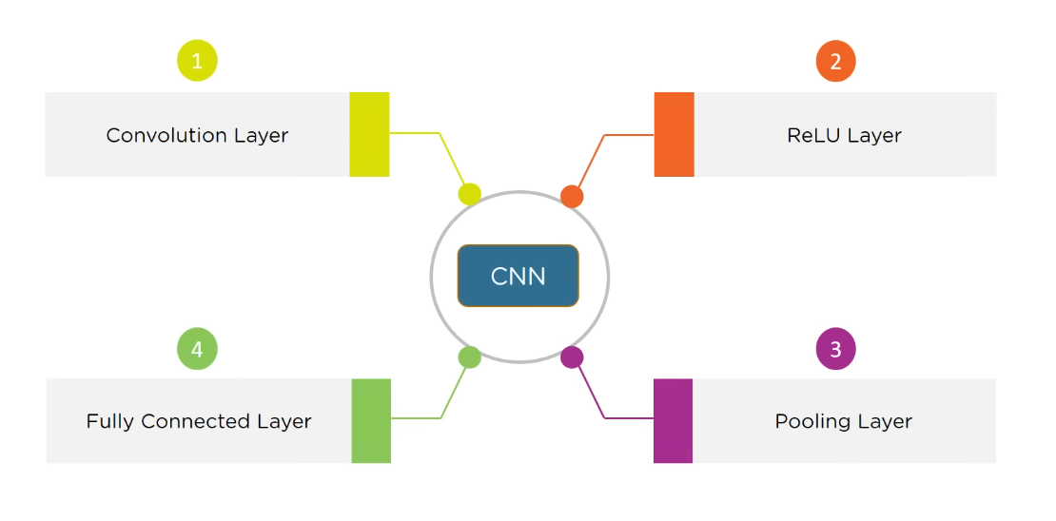
Components of CNNs

Slide 17
What are CNNs
At the very beginning of this process, an input image is broken down into pixels. For a black and white image, those pixels are interpreted as a 2D array (for example 2 x 2 pixels). Every pixel has a value between 0 and 255. (Zero is completely black and 255 is completely white. The grayscale exists between those numbers.) Based on that information, the computer can begin to work on the data.
For a color image, this is a 3D array with a blue layer, a green layer, and a red layer. Each one of those colors has its own value between 0 and 255. The color can be found by combining the values in each of the three layers.
Feature extraction and classification are carried out in further stages of the CNN using the information from these pixels.

Slide 18
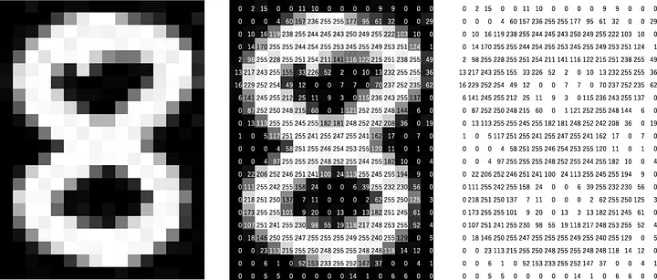
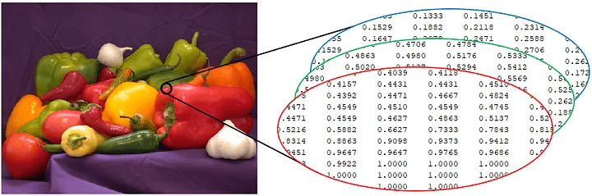
What are CNNs
Source: Medium.com

Slide 19
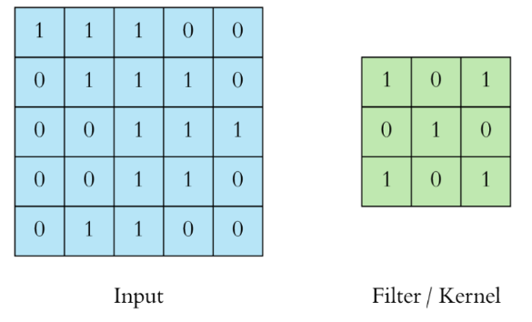
Convolution Layer
Convolution is the process of combining two functions to produce the output of the other function. It is a grouping function where two matrices are combined to generate a third array.
A convolution layer often contains input vectors, such as an image, filters, such as a feature detector, and output vectors, such as a feature map.
The image is abstracted to a feature map, also known as an activation map, after passing through a convolutional layer.
Source: towardsdatascience.com

Slide 20
Convolution Layer
The main purpose of the convolution step is to extract features from the input image.
At each position, the filter conducts element-wise multiplication between its values and the original pixel values. The resulting products are then summed to generate a single number representing the group of pixels. This process is repeated as the filter moves across the entire input matrix. The resulting array is referred to as a feature map or an activation map.
Feature detectors / Filters can be set up with different values to get different results. For example, a filter can be applied that can sharpen and focus an image or blue an image.
Many filters can be created, each of which catches a different aspect from the input. Kernels are another name for filters.

Slide 21
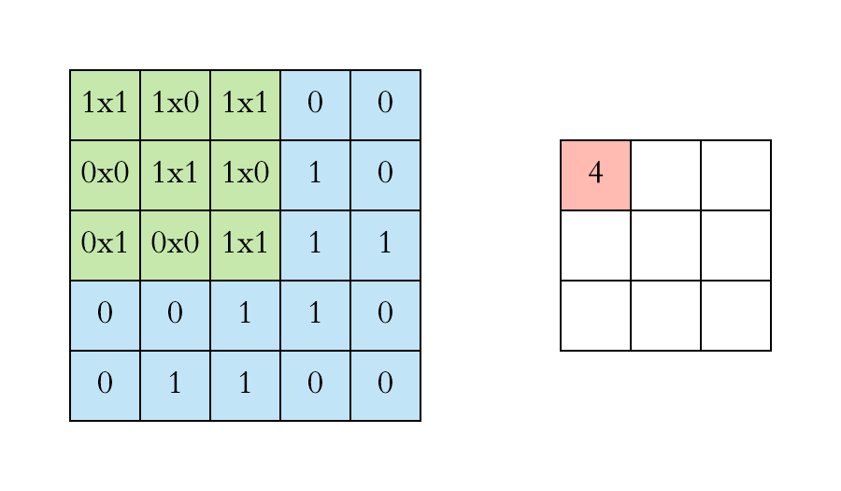
Convolution Layer
Source: towardsdatascience.com

Slide 22



Convolution Layer
Source: Coding Lane

Slide 23
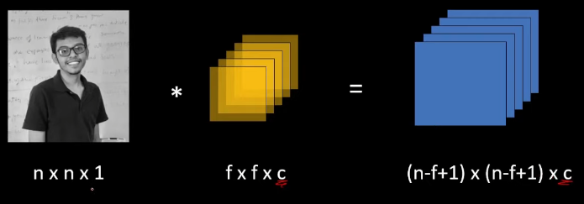
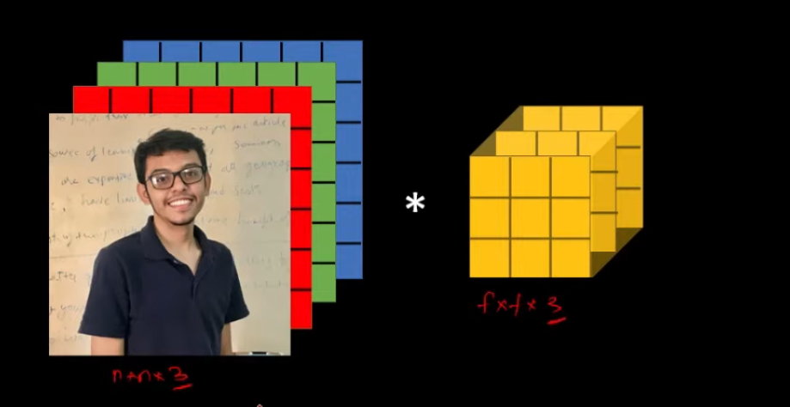
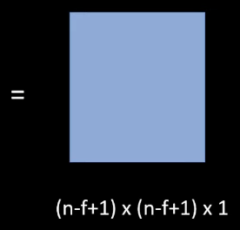
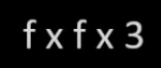
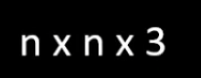
Convolution Layer
Source: Coding Lane

Slide 24
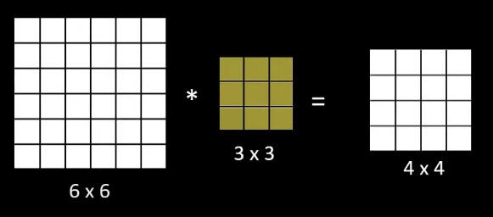
Padding and Stride
Padding and stride have an impact on how the convolution procedure is carried out. They can be used to increase or decrease the dimensions (height and width) of input/output vectors.
After a convolution operation is performed, the size of the output matrix gets reduced by some amount. Using a large number of filters, the size of the output can get reduced very drastically and sometimes leads to loss of valuable information which could have been extracted.
Source: Coding Lane

Slide 25
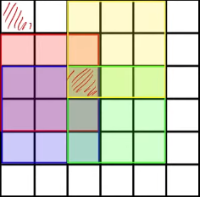
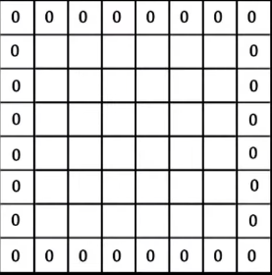
Padding and Stride
Another problem with the convolution operation is that the corner pixels do not get enough exposure compared to the ones which are closer to the center.
We see that the corner pixel gets exposed to the
Convolution operation only once while the one at the
center gets exposed multiple times.
To overcome these problems we can pad the input
image with zeroes. Once this padding is applied,
and the convolution operation is performed, the
final output size is not reduced much.
Source: Coding Lane

Slide 26
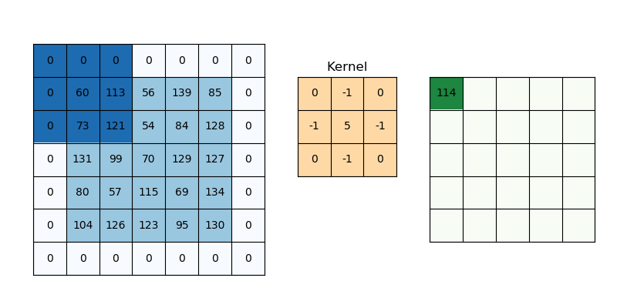
Padding and Stride
Convolution operation can be performed with or without padding. A convolution
operation performed without padding is called Valid Convolution, while a
convolution operation performed with a certain padding that results in the same size
of the output as the input image is called Same Convolution.
Source: vitalflux.com

Slide 27
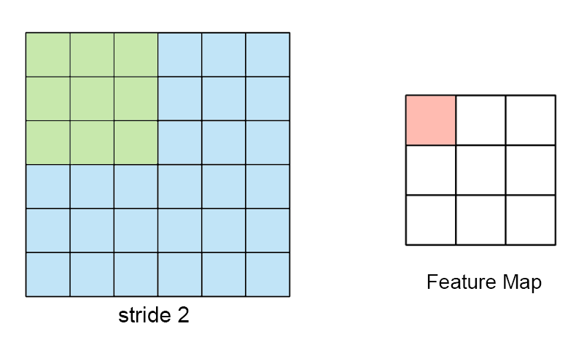
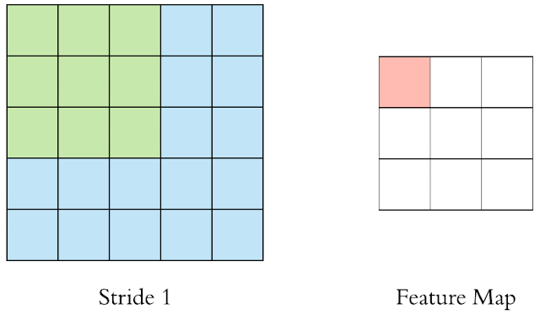
Padding and Stride
Stride determines how the filter convolves over the input matrix, i.e. how many
Pixels shift. When stride is set to 1, the filter moves across one pixel at a time, and
when the stride is set to 2, the filter moves across two pixels at a time. The smaller
the stride value, the smaller the output, and vice versa.
Size of final output after applying Stride of size s and filter f to input of size n:
floor ([(n-f)/s] + 1)
Source: Medium.com

Slide 28
Activation Function
So once the convolution process gets over for our input dataset, the next important
step to proceed in the CNN algorithm is the activation function.
It takes in the output signal from the previous neuron and converts it into some form
that can be taken as input to the next neuron.
It’s a non-linear transformation that we do for inputs that we receive before
sending them to the next layer or neuron.
Convolution is a linear operation with operations like element wise matrix
multiplication and addition. However, the real-world data that the CNN has to learn
will be non-linear. This can be accounted for with an operation like ReLU, tanh or
Sigmoid.
Activation functions applied onto your feature maps basically increase non-linearity
nn the network.

Slide 29
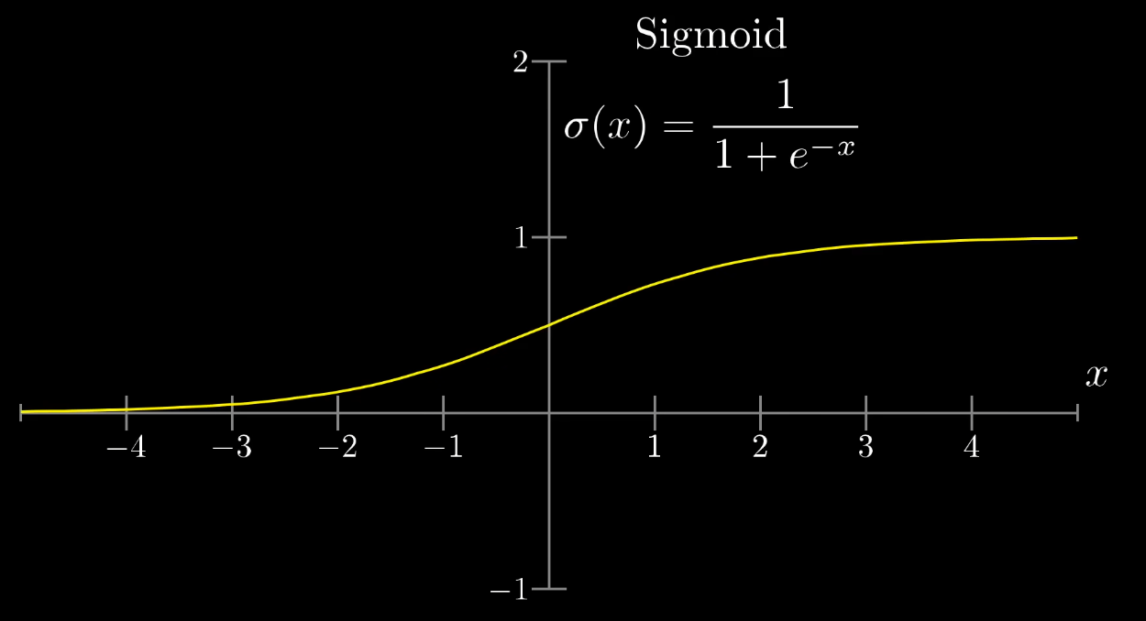
Sigmoid Function
Constricts any real number input value between 0 and 1
Source: 3 Blue 1 Brown

Slide 30
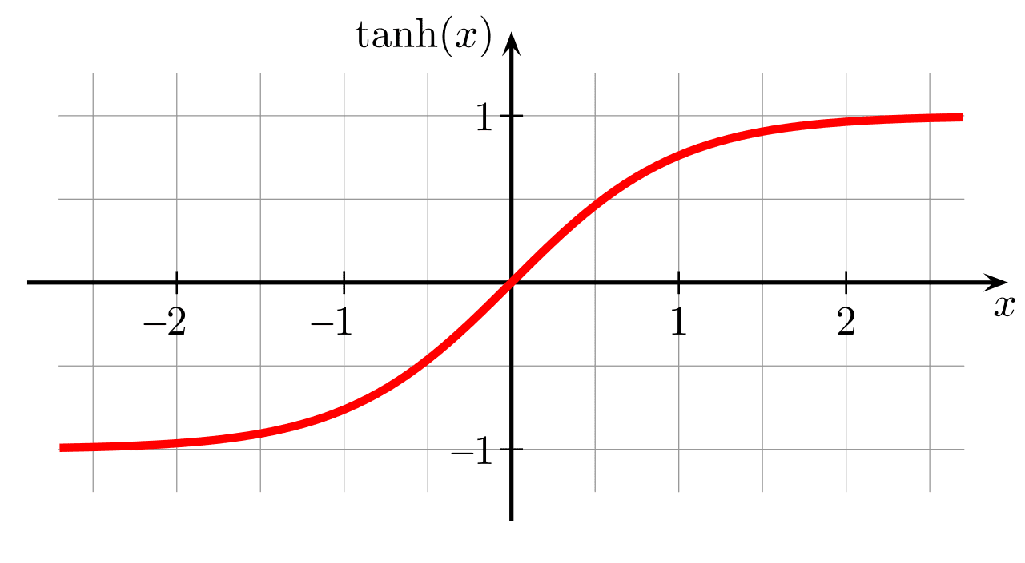
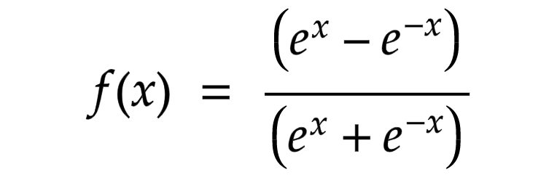
tanh Function
Constricts any real number input value between -1 and 1
Source: Wikipedia.org

Slide 31
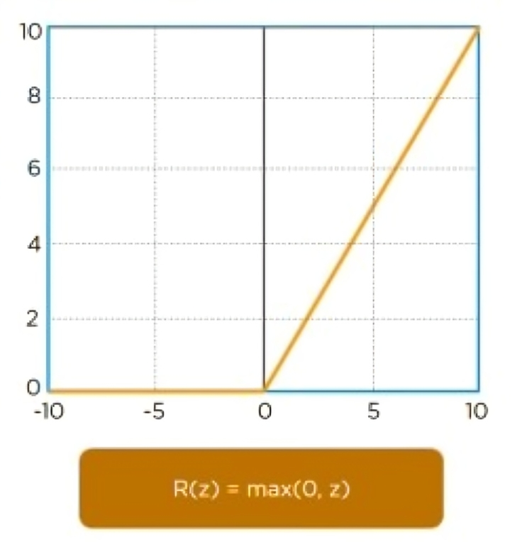
ReLU Function
Converts the negative inputs to zero and retains the positive inputs as it is
Source: Simplilearn.com

Slide 32
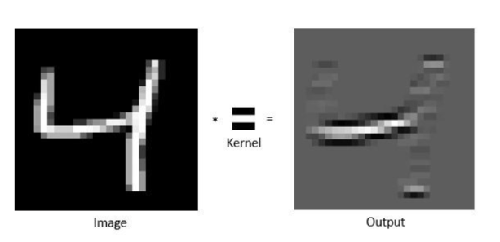
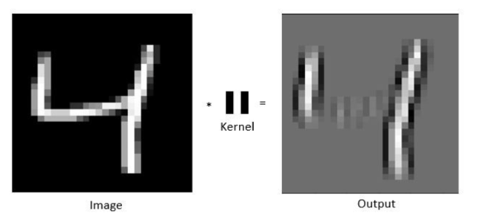
ReLU Function
Source: towardsdatascience.com

Slide 33
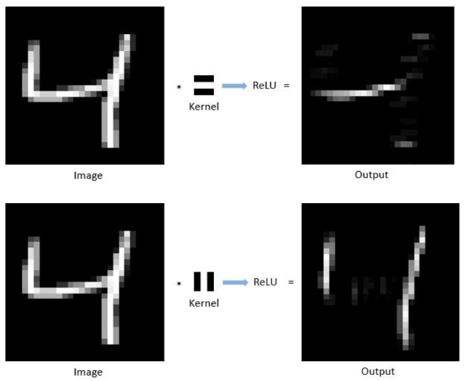
ReLU Function
Source: towardsdatascience.com

Slide 34
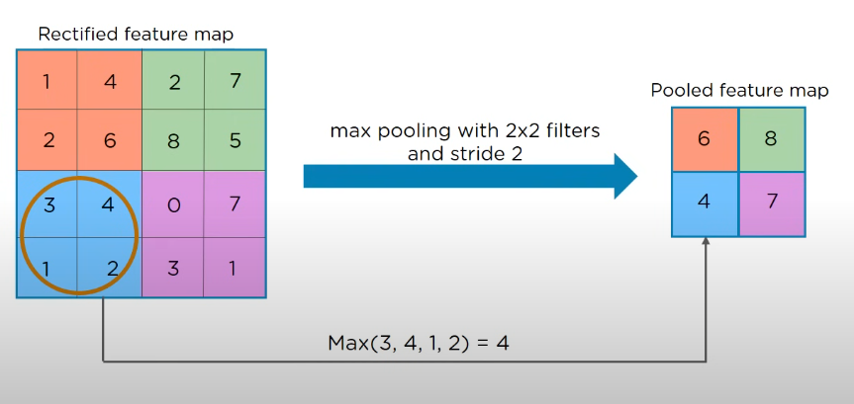
Pooling Layer
Pooling is a down-sampling operation that reduces the dimentionality of the feature
Map.
Pooling gradually reduces the spatial dimension of the representation to reduce the
computations in the network, as well as to prevent overfitting. It does not involve
any parameter and hence no training is required.
It reduces the image size and hance reduces the computational cost required for
training the neural network.
Source: Simplilearn.com

Slide 35
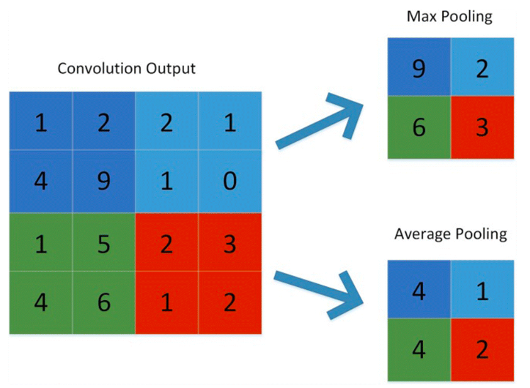
Pooling Layer
Max-pooling: It chooses the most significant element from the feature map. The
feature map’s significant features are stored in the resulting max-pooled layer. It is
the most popular method since it produces the best outcomes.
Average pooling: It entails calculating the average for each region of the feature map
Source: Springer.com

Slide 36
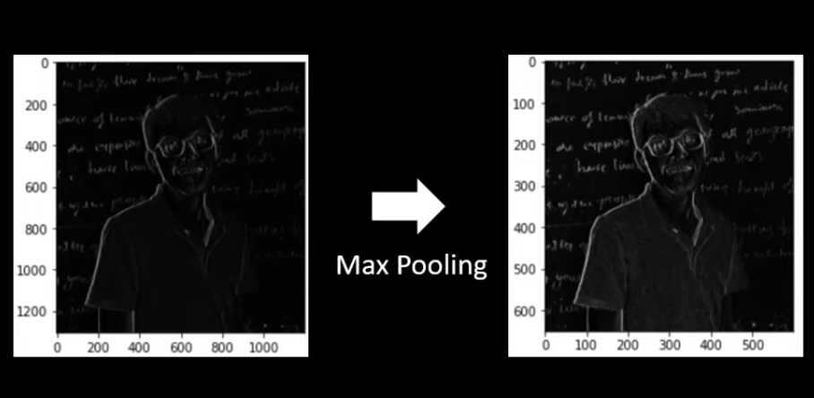
Pooling Layer
One more advantage of Max-Pooling is that it enhances the features that have been
extracted from the convolution layer.
Source: Springer.com

Slide 37
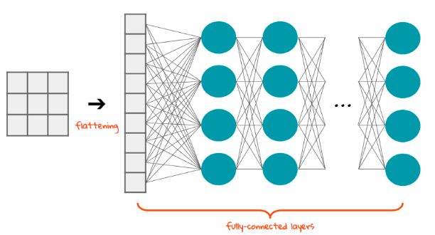
Flattening
Flattening is converting the data into a 1-dimensional array for inputting it to the next layer. We flatten the output of the convolutional layers to create a single long feature vector. And it is connected to the final classification model, which is called a fully connected layer.
Source: towardsdatascience.com

Slide 38
Fully Connected Layer
The fully connected layer is a traditional Multi-Layer Perceptron. The flattened
output is fed to a feed-forward neural network and backpropagation is applied to
every iteration of training.
Fully connected means every neuron in the previous layer connects to every neuron in the next layer. Every activation unit in the next layer is coupled to all of the inputs from this layer.
Over a series of epochs, the fully connected layer can distinguish between dominating and certain low-level features in images and classify them. This layer assigns random weights to the inputs and predicts a suitable label.
The last layer of this network is called output layer which uses a classifier. The classifier is usually a softmax activation function.

Slide 39
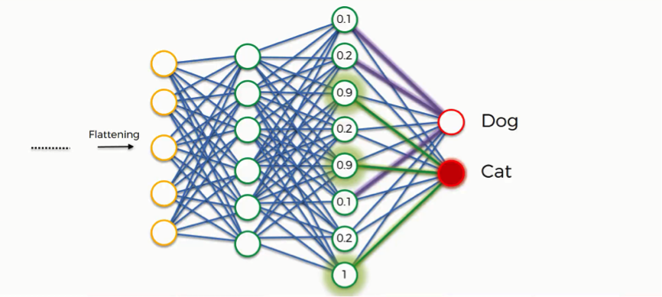
Fully Connected Layer
Source: superdatascience.com

Slide 40
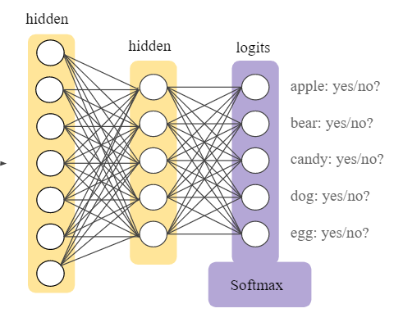
Softmax Function
Soft-max is an activation layer that is typically applied to the network’s last layer, which serves as a classifier. This layer is responsible for categorizing provided input into distinct types. A network’s non-normalized output is mapped to a probability distribution using the softmax function.
This brings the values between 0 and 1 and makes them add up to 1 (100%). The Softmax function takes a vector of scores and squashes it to a vector of values between 0 and 1 that add up to 1
Source: superdatascience.com

Slide 41
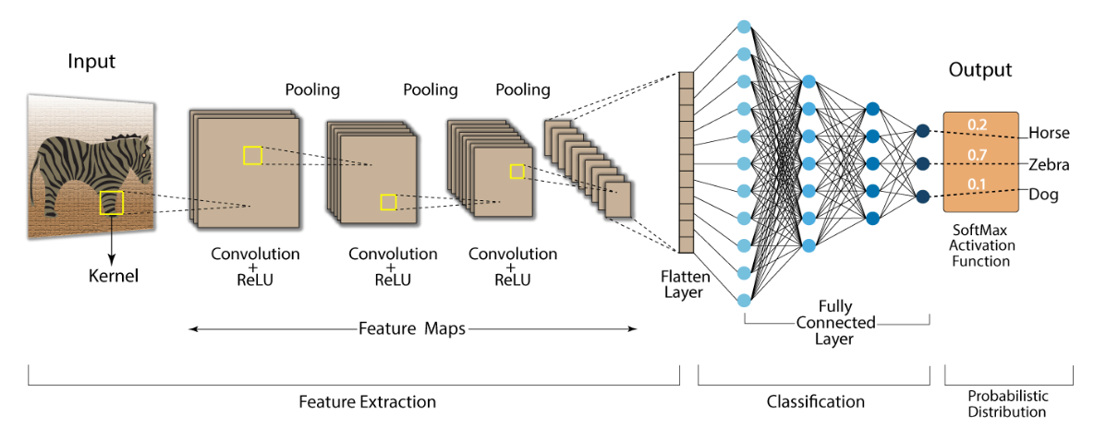
Summary of CNN
Source: medium.com

Slide 42



Slide 43
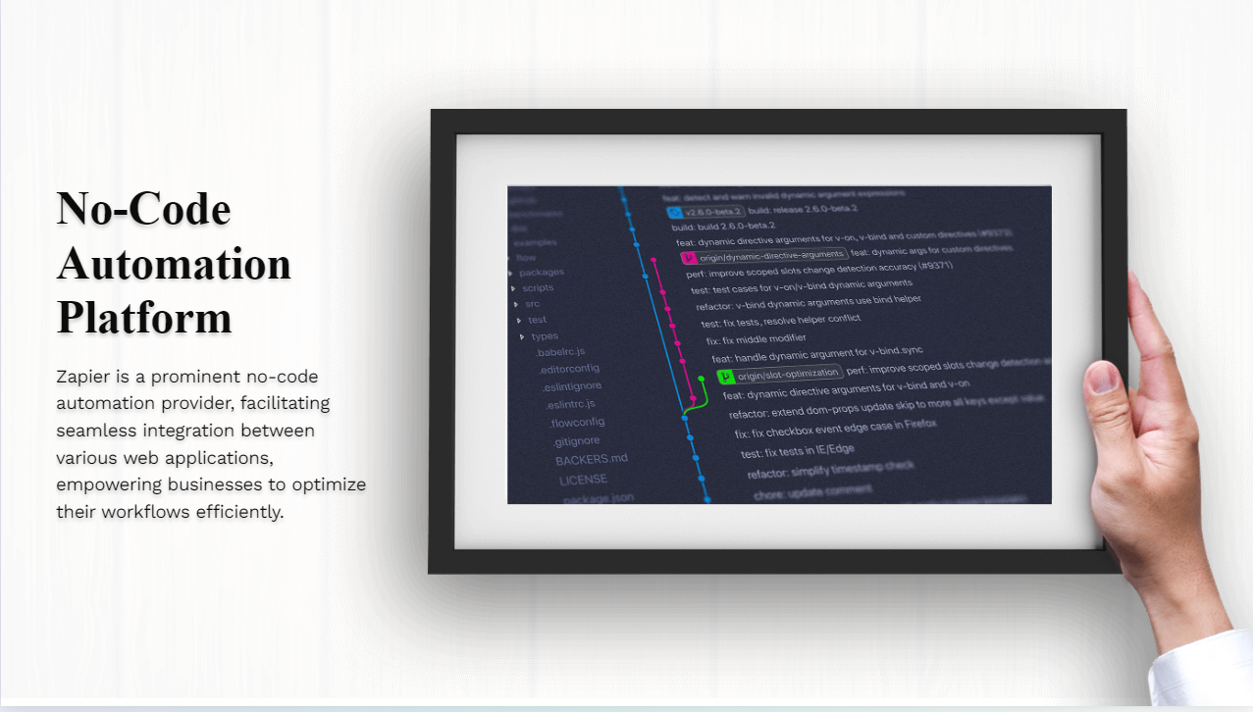

Slide 44



Slide 45

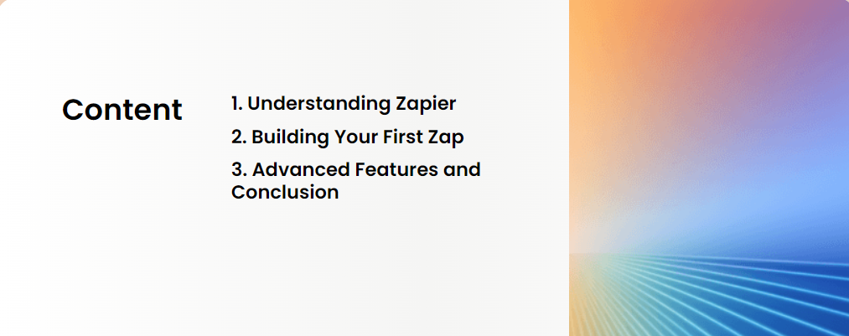

Slide 46




Slide 47
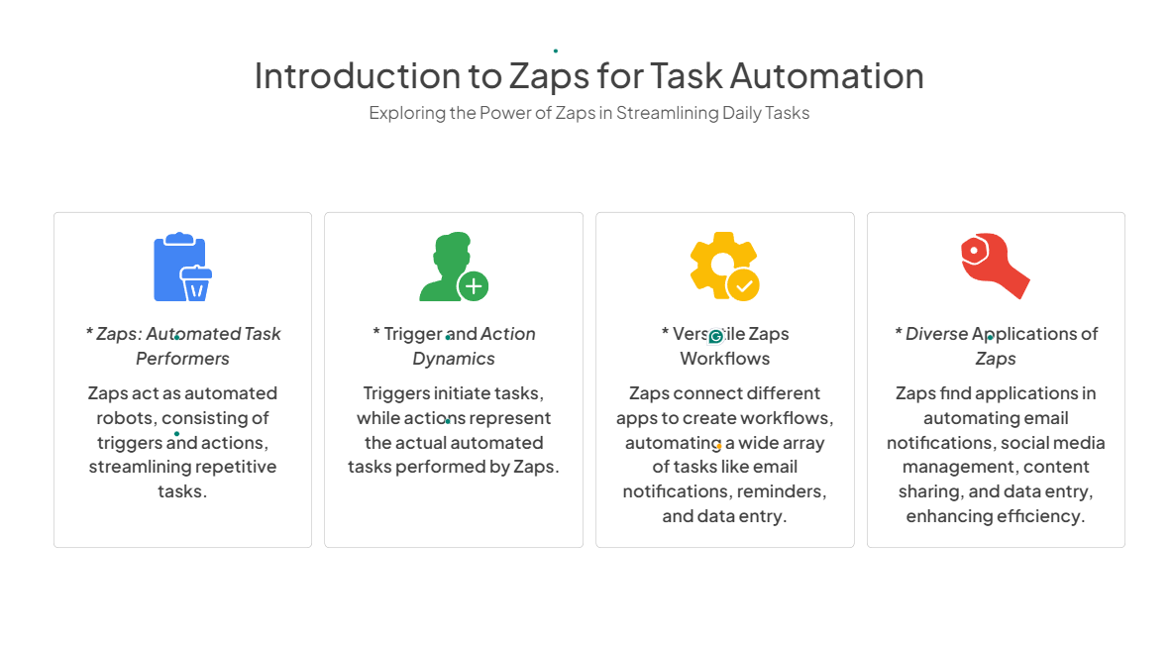

Slide 48


Slide 49

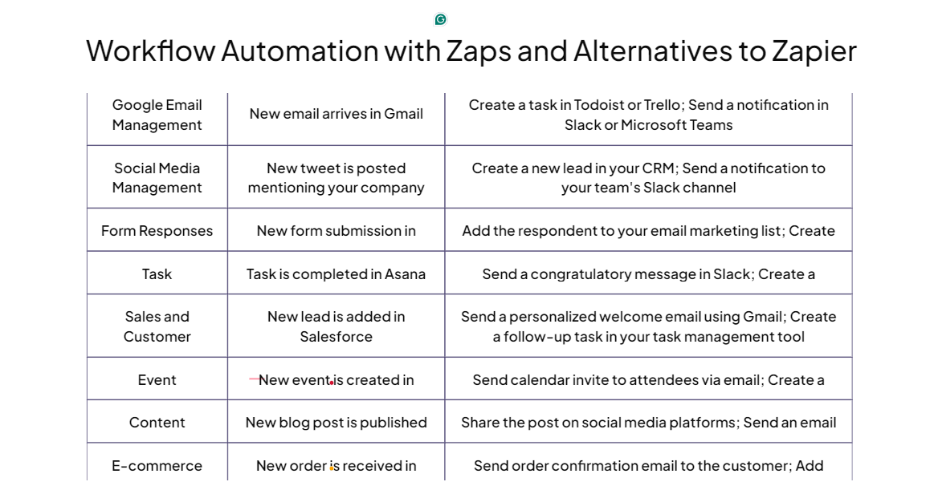

Slide 50


Slide 51


Slide 52
Quiz Time
1. What are the advantages of Max Pooling Layer?
Increases non-linearity in the network
Reduces computation cost
Enhances features of the convolved image
All of the above

Slide 53
Quiz Time
1. What are the advantages of Max Pooling Layer?
Increases non-linearity in the network
Reduces computation cost
Enhances features of the convolved image
All of the above

Slide 54
Quiz Time
1. What are the advantages of Max Pooling Layer?
Increases non-linearity in the network
Reduces computation cost
Enhances features of the convolved image
All of the above
2. What will be the size of the final image for an input of size 6, filter of size 3 and stride 1?
1 B. 2 C. 3 D. 4

Slide 55
Quiz Time
1. What are the advantages of Max Pooling Layer?
Increases non-linearity in the network
Reduces computation cost
Enhances features of the convolved image
All of the above
2. What will be the size of the final image for an input of size 6, filter of size 3 and stride 1?
1 B. 2 C. 3 D. 4

Slide 56
Quiz Time
1. What are the advantages of Max Pooling Layer?
Increases non-linearity in the network
Reduces computation cost
Enhances features of the convolved image
All of the above
2. What will be the size of the final image for an input of size 6, filter of size 3 and stride 1?
1 B. 2 C. 3 D. 4
3. What will be the resulting output signal of a ReLU function when an input signal of value 13 is passed to it?
A. 0 B. 1 C. 13 D. -13

Slide 57
Quiz Time
1. What are the advantages of Max Pooling Layer?
Increases non-linearity in the network
Reduces computation cost
Enhances features of the convolved image
All of the above
2. What will be the size of the final image for an input of size 6, filter of size 3 and stride 1?
1 B. 2 C. 3 D. 4
3. What will be the resulting output signal of a ReLU function when an input signal of value 13 is passed to it?
A. 0 B. 1 C. 13 D. -13

Slide 58
Quiz Time
5. What is the primary purpose of Zaps in Zapier?
To connect apps and perform automated tasks
To manage user accounts
To provide customer support
To analyse data

Slide 59
Quiz Time
5. What is the primary purpose of Zaps in Zapier?
To connect apps and perform automated tasks
To manage user accounts
To provide customer support
To analyse data

Slide 60
Quiz Time
5. What is the primary purpose of Zaps in Zapier?
To connect apps and perform automated tasks
To manage user accounts
To provide customer support
To analyse data
6. What are the two main components of a Zap in Zapier?
Reaction and Response
Trigger and Action
Start and finish
Initiation and execution

Slide 61
Quiz Time
5. What is the primary purpose of Zaps in Zapier?
To connect apps and perform automated tasks
To manage user accounts
To provide customer support
To analyse data
6. What are the two main components of a Zap in Zapier?
Reaction and Response
Trigger and Action
Start and finish
Initiation and execution

Slide 62
Quiz Time
7. How many triggers can zap have?
Only one
Two
Unlimited
Three

Slide 63
Quiz Time
7. How many triggers can zap have?
Only one
Two
Unlimited
Three

Slide 64
Quiz Time
7. How many triggers can zap have?
Only one
Two
Unlimited
Three
8. Which automation platform is known for its user-friendly interface and intuitive workflow builder?
A. Integromat
B. IFTTT
C. Zapier
D. Microsoft Power Automate

Slide 65
Quiz Time
7. How many triggers can zap have?
Only one
Two
Unlimited
Three
8. Which automation platform is known for its user-friendly interface and intuitive workflow builder?
A. Integromat
B. IFTTT
C. Zapier
D. Microsoft Power Automate

Slide 66


Slide 67


Slide 68
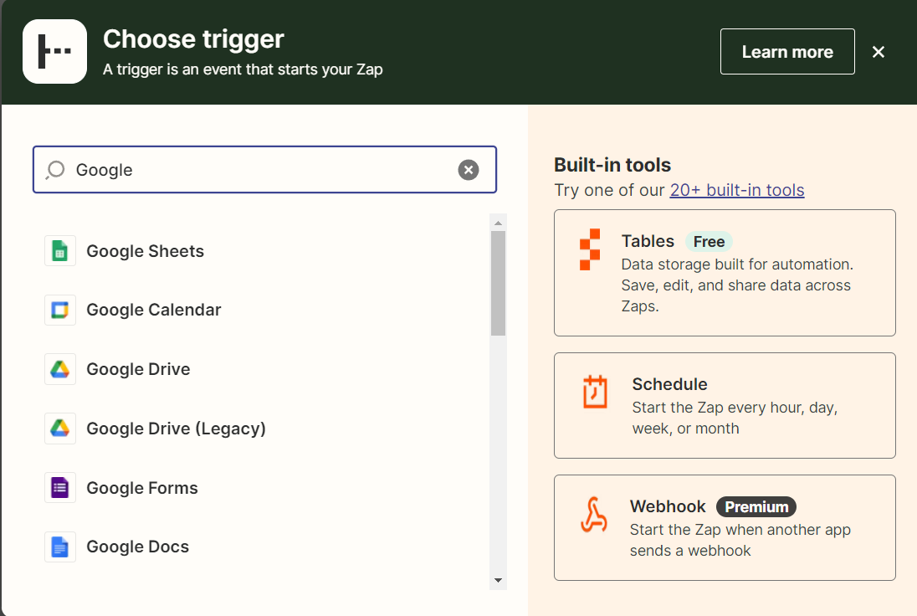
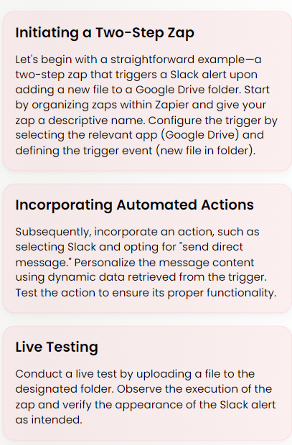
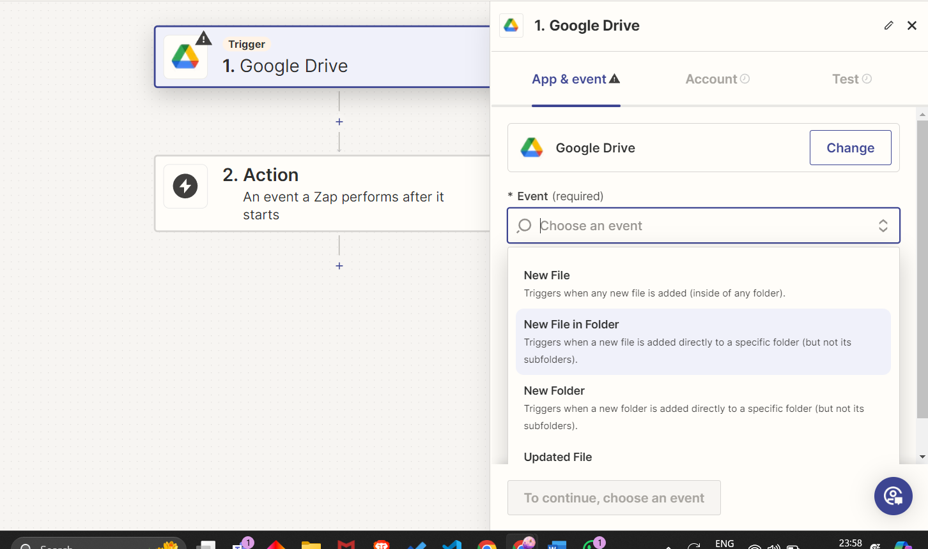

Building Your First Zap

Slide 69


Slide 70
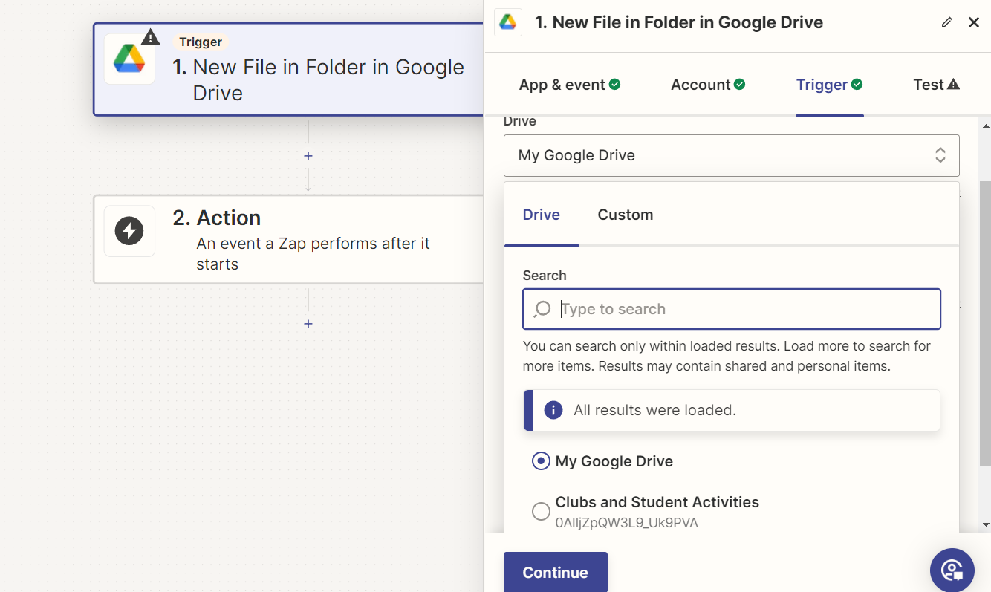
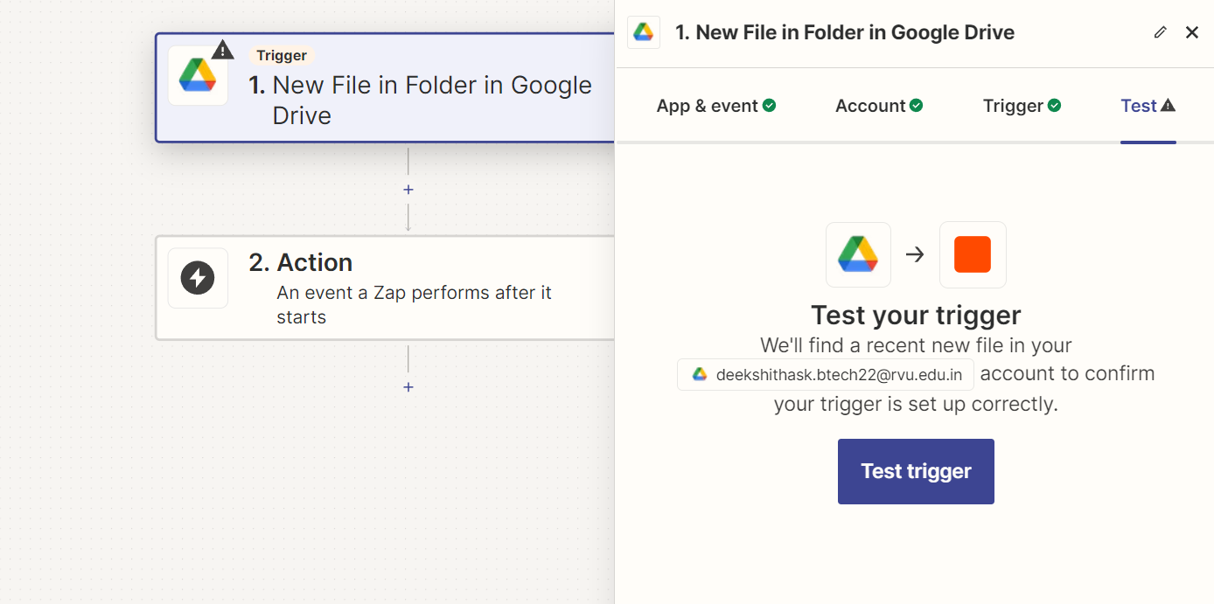
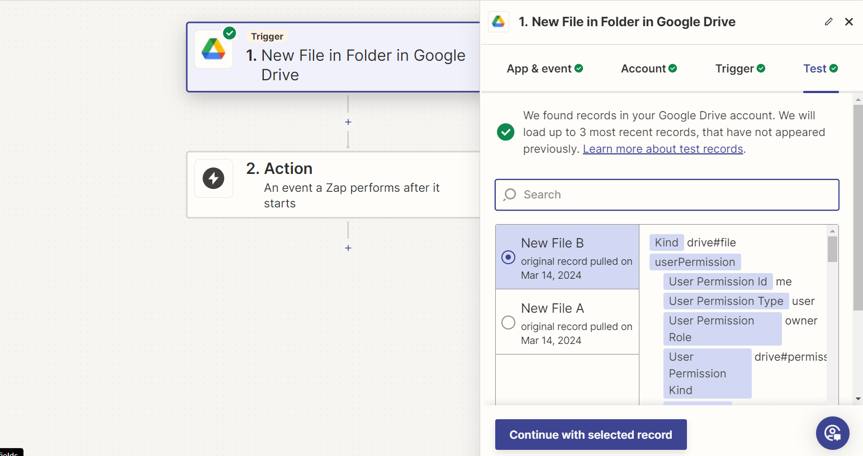

Slide 71
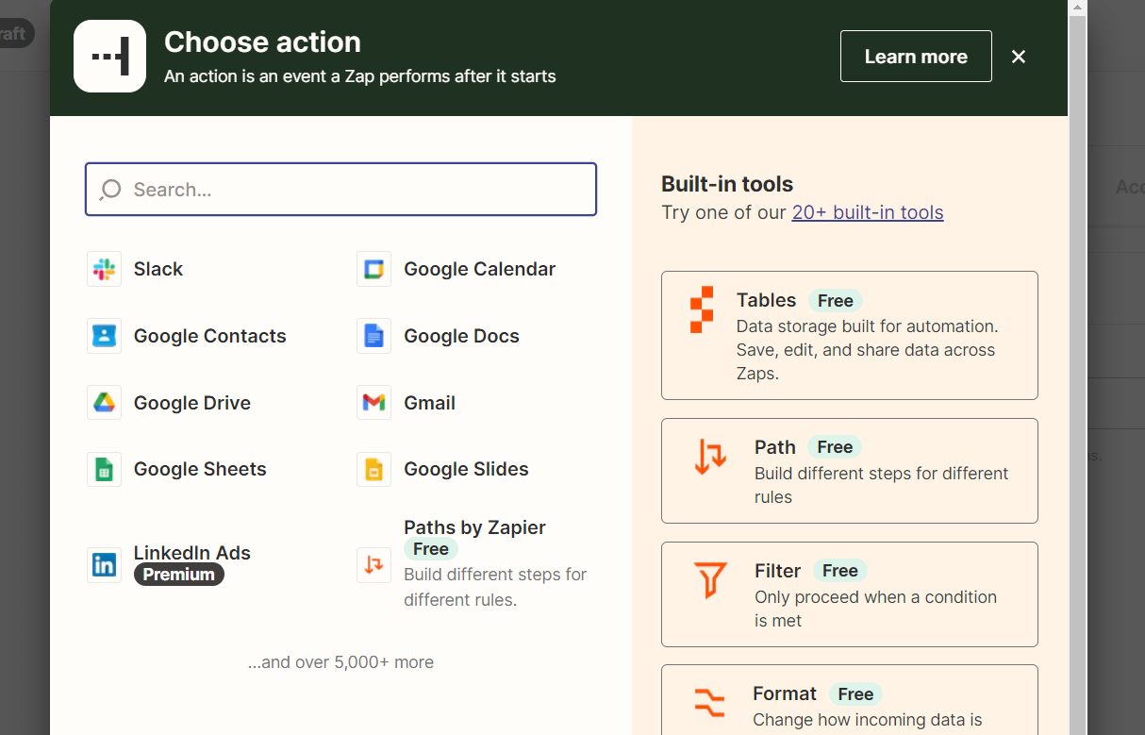
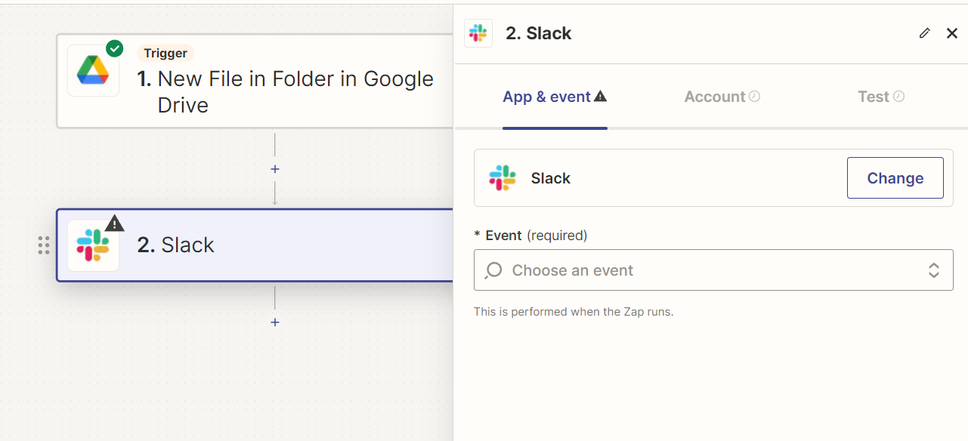
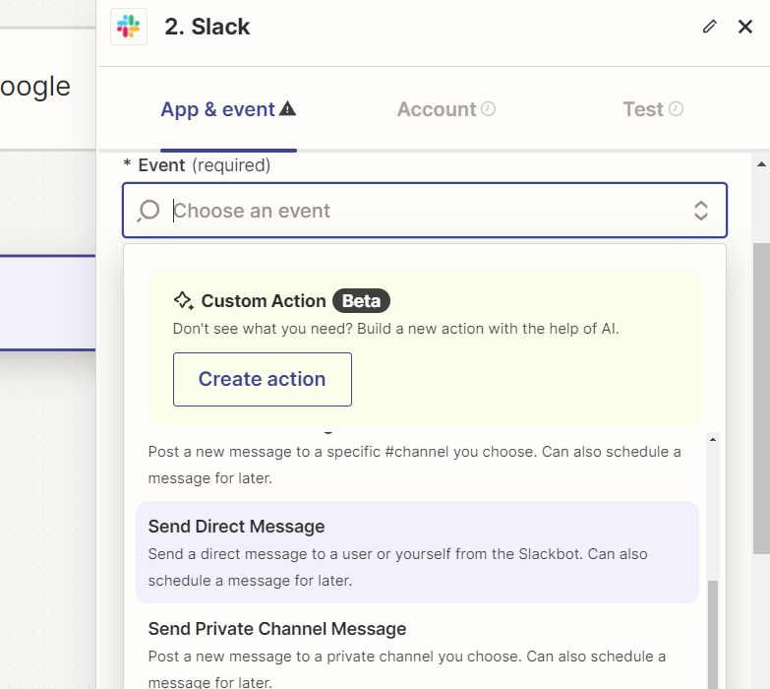

Slide 72
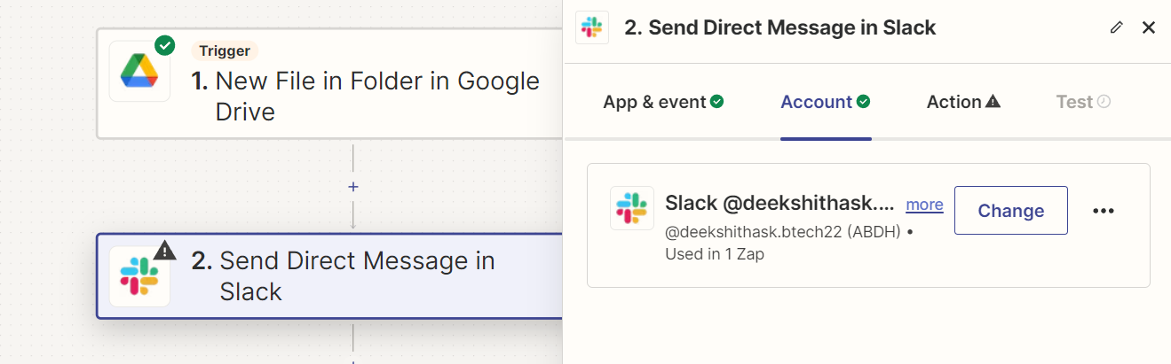


Slide 73



Slide 74


Slide 75

Testing the Zap: Conduct a live test by uploading a file to the designated folder. Observe the execution of the zap and verify the appearance of the Slack alert as intended.

